Slide 1



Music Genre Classification
Submitted by: Siddharth Shetty
Under the guidance of
Prof. Dr. Ireneusz Jablonski

Slide 2

Key Tasks:
Audio Processing: Extract meaningful features like pitch, rhythm, and timbre.
Model Training: Use a pre-trained machine learning model for classification.
Prediction: Predict genre for audio files based on extracted features.
Applications: Music recommendation systems, audio search engines, entertainment technologies.

Slide 3
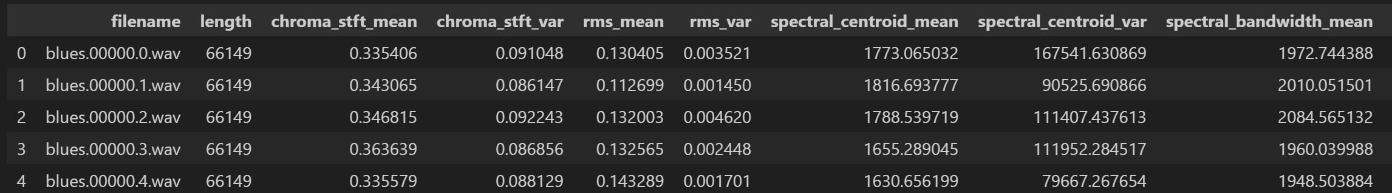
Materials and Methods
Dataset: GTZAN Dataset 1,000 audio tracks, each of 30 seconds long 10 genres
Blues Jazz
Metal Pop
Reggae Classical
Rock Country
Disco Hiphop
CSV file with pre-computed features. (9990 rows, 60 columns)
Example file: classical.00096.wav.

Slide 4
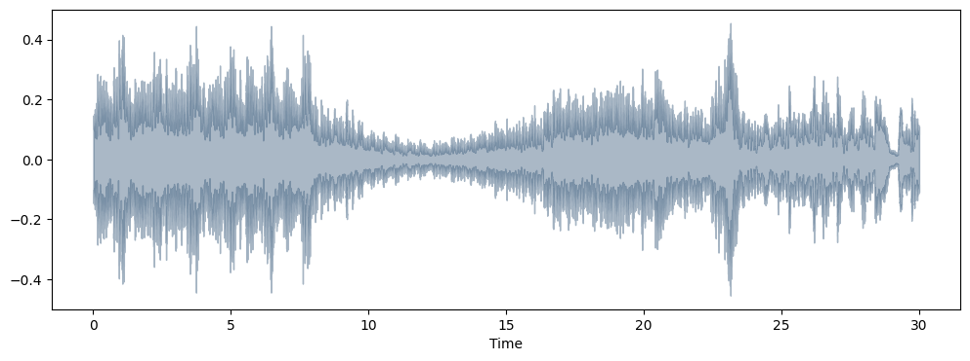
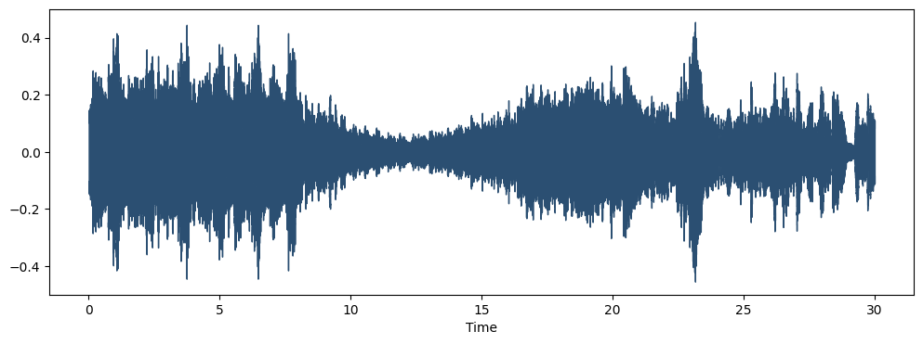
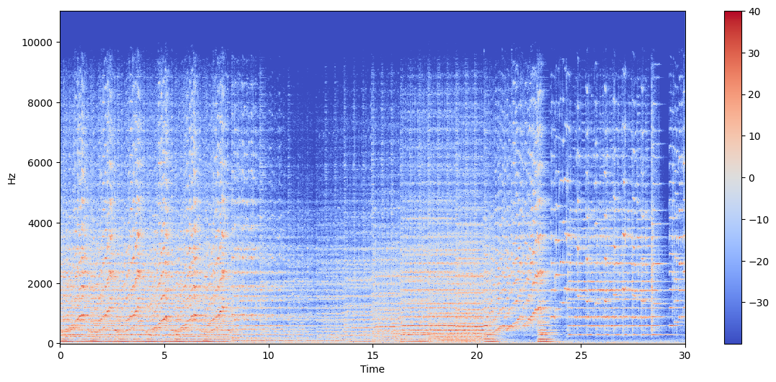
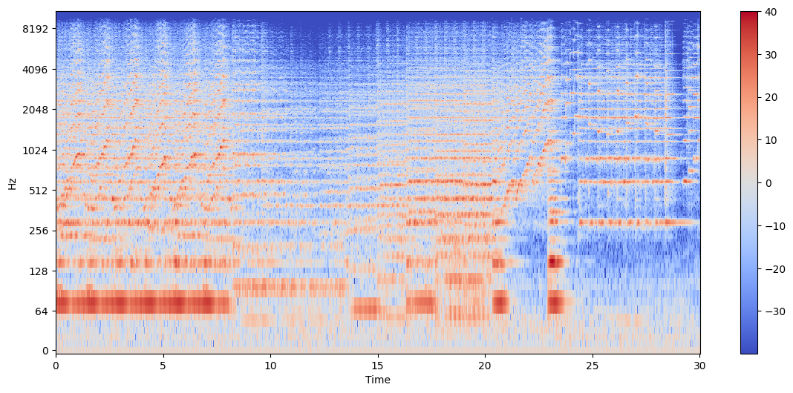
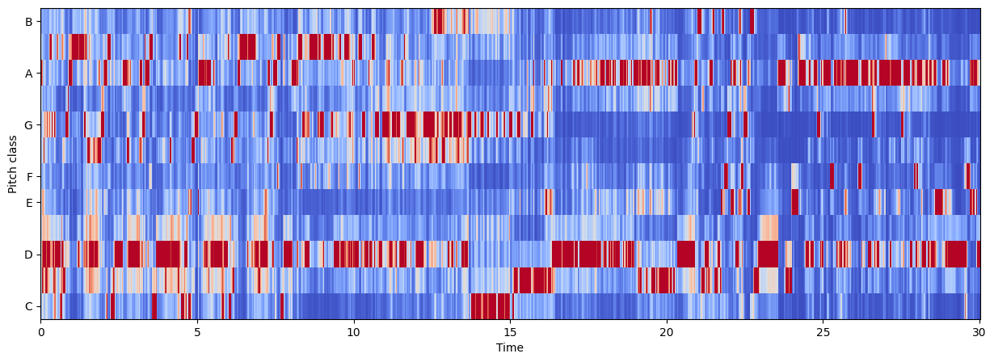
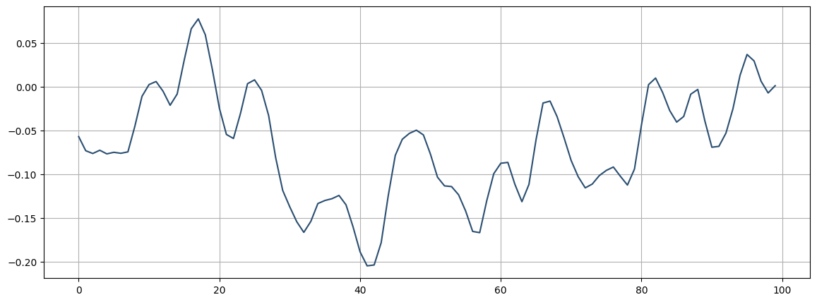
Waveform
Spectrogram
Zero crossings
Piano roll / Pitch-class heatmap

Slide 5
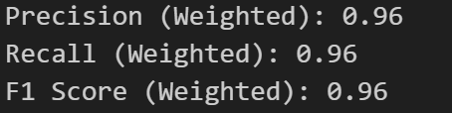
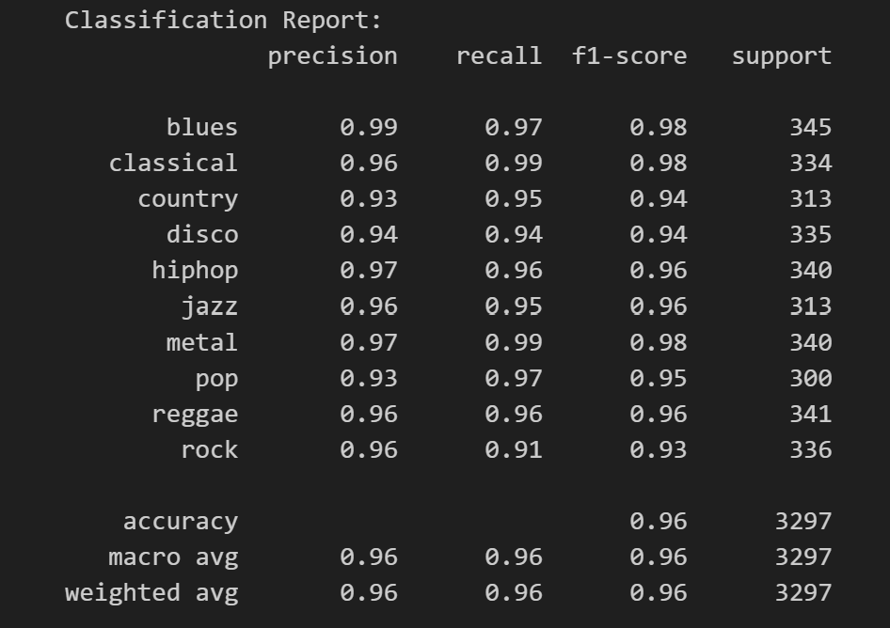
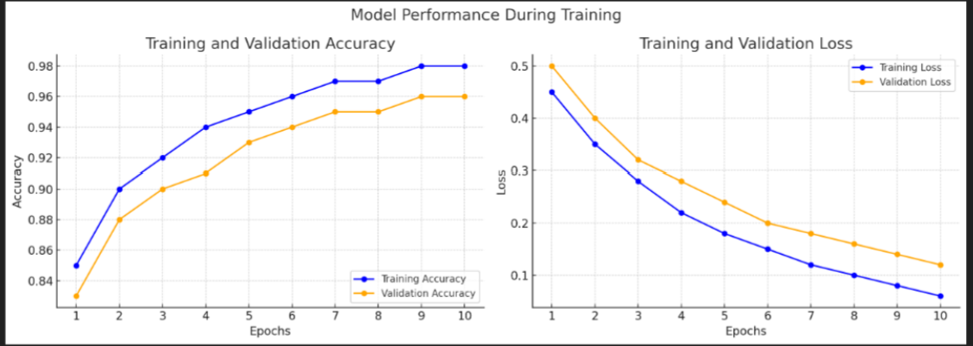
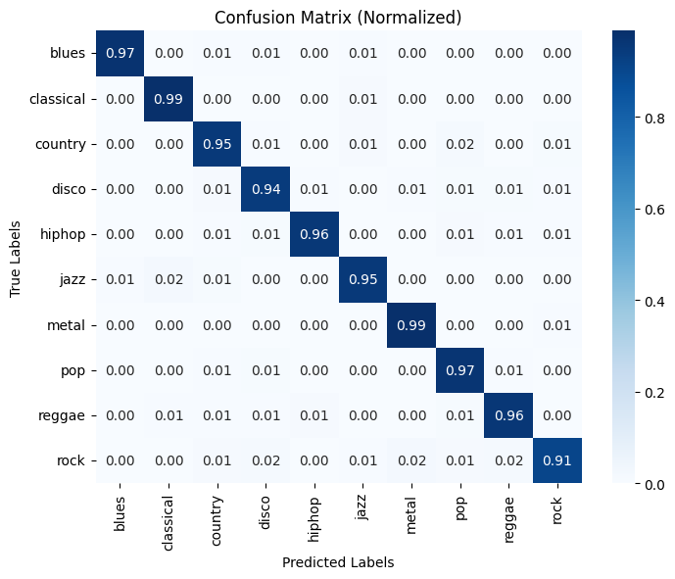
Results
Key Observations:
The model performs well across all genres, with an overall accuracy of 96%.
Blues, Classical, and Metal have the highest F1-scores (0.98), indicating strong performance.
Rock has the lowest recall (0.91), suggesting that some rock music samples are misclassified.
Macro Avg (simple average across all classes) and Weighted Avg (weighted by support) both yield 0.96, indicating consistent performance across all classes.
Overall, the model is highly accurate, with slight misclassification in some classes like "rock" and "country."

Slide 6

Future Work

Slide 7



Adaptive Music Composition
AI-Driven
Music Therapy
AR/VR Dynamic Background Music

Slide 8

THANK YOU

